Slide 1
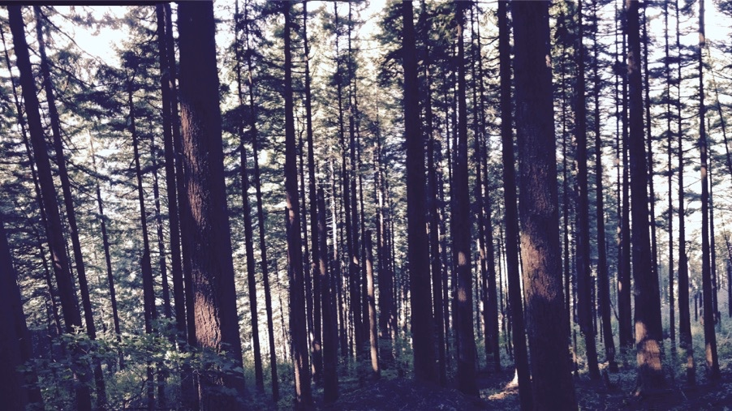
Using least cost optimality to reliably simulate photosynthetic acclimation
Nick Smith
Department of Biological Sciences
Texas Tech University

Slide 2
Plants acclimate to environmental conditions
nick.smith@ttu.edu; @nick_greg_smith
Level of operation
Population
Plant
Acclimation
Leaf
Instantaneous response
Cell
Seconds
Minutes
Days
Years
Response time
Smith and Dukes (2013)

Slide 3
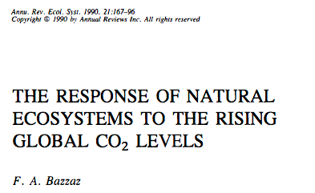
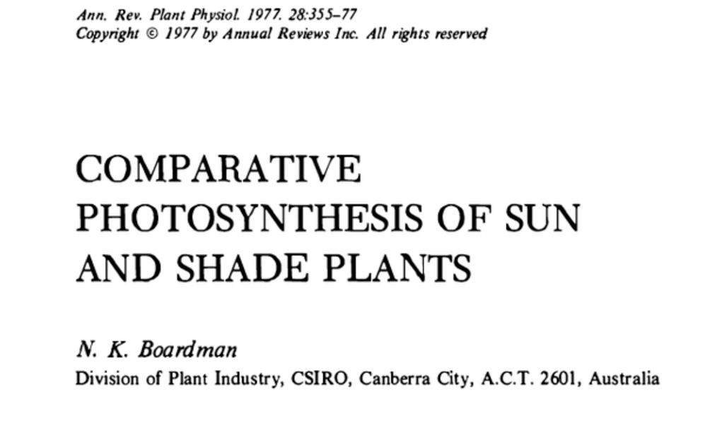
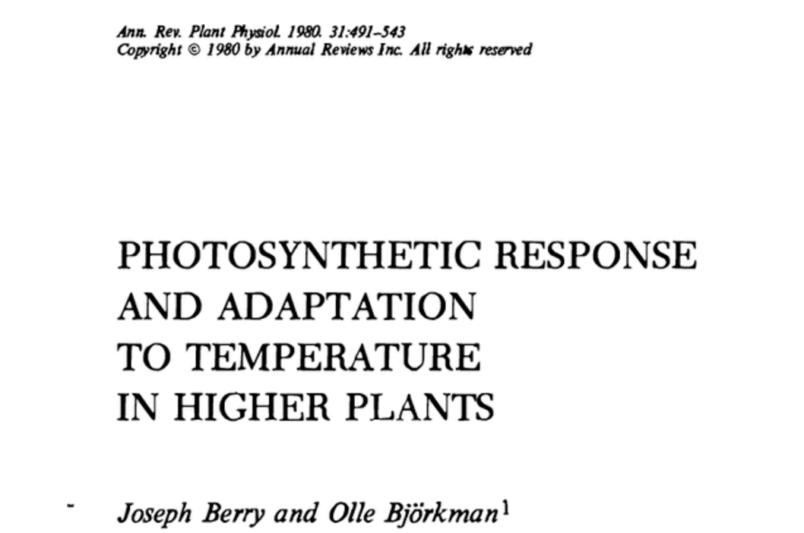
Photosynthetic acclimation is ubiquitous and well known…
nick.smith@ttu.edu; @nick_greg_smith
Temperature: Berry & Björkman (1980)
CO₂: Bazzaz (1990)
Light: Boardman (1977)

Slide 4
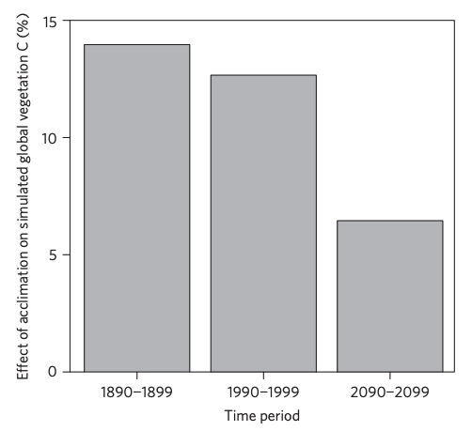
…and can possibly impact carbon cycling and climate
nick.smith@ttu.edu; @nick_greg_smith
Acclimation increase future C storage by ~6%
Acclimation alters future temperature by >1°C
Smith et al. (2017) Nature Climate Change
Smith et al. (2017) JAMES

Slide 5
Here’s the rub: No theoretical model for photosynthetic acclimation exists
nick.smith@ttu.edu; @nick_greg_smith

Slide 6
Lack of theory results in…
nick.smith@ttu.edu; @nick_greg_smith

Slide 7
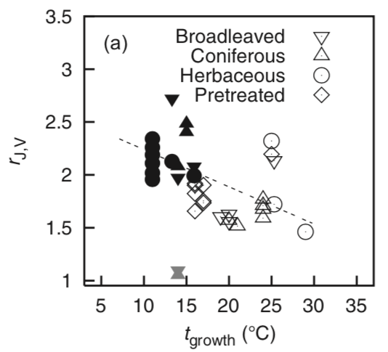
Lack of theory results in…
nick.smith@ttu.edu; @nick_greg_smith
Unreliable future predictions (overparameterization, tuning)
Reliance on statistical models
Resulting change in simulated photosynthesis
Physiological parameter
Environmental condition
Kattge and Knorr (2007) PC&E
Smith et al. (2017) JAMES

Slide 8
So, we developed a mechanistic model of photosynthetic acclimation Based on least cost optimization and the first principles of plant physiological theory
nick.smith@ttu.edu; @nick_greg_smith

Slide 9
Least cost theory
nick.smith@ttu.edu; @nick_greg_smith
Maintain fastest rate of photosynthesis at the lowest cost (water and nutrient use)
Wright et al. (2003) American Naturalist

Slide 10
Optimal photosynthesis
nick.smith@ttu.edu; @nick_greg_smith
Photosynthesis = f{stomatal conductance,
photosynthetic biochemistry}

Slide 11
Optimal photosynthesis
nick.smith@ttu.edu; @nick_greg_smith
Photosynthesis = f{stomatal conductance,
photosynthetic biochemistry}
Must predict optimal rates of both

Slide 12
Optimal photosynthesis
nick.smith@ttu.edu; @nick_greg_smith
Photosynthesis = f{stomatal conductance,
photosynthetic biochemistry}

Slide 13
Optimal photosynthesis
nick.smith@ttu.edu; @nick_greg_smith
Photosynthesis = f{stomatal conductance,
photosynthetic biochemistry}
OTPIMAL CONDUCTANCE IS NOW COMMONPLACE IN MOST MODELS
e.g., Prentice et al. (2014), Medlyn et al. (2011)

Slide 14
Optimal photosynthesis
nick.smith@ttu.edu; @nick_greg_smith
Photosynthesis = f{stomatal conductance,
photosynthetic biochemistry}

Slide 15
Biochemistry optimization: Coordination hypothesis
nick.smith@ttu.edu; @nick_greg_smith
Plant biochemistry setup will aim for equal limitation by all factors

Slide 16
nick.smith@ttu.edu; @nick_greg_smith
A_{j} = A_{c}
A_{j} = f{light, T, CO₂}
A_{c} = f{V_{cmax}, T, CO₂}
Smith et al. (2019)

Slide 17
nick.smith@ttu.edu; @nick_greg_smith
V_{cmax} = f {light, T, CO₂}
Smith et al. (2019)

Slide 18
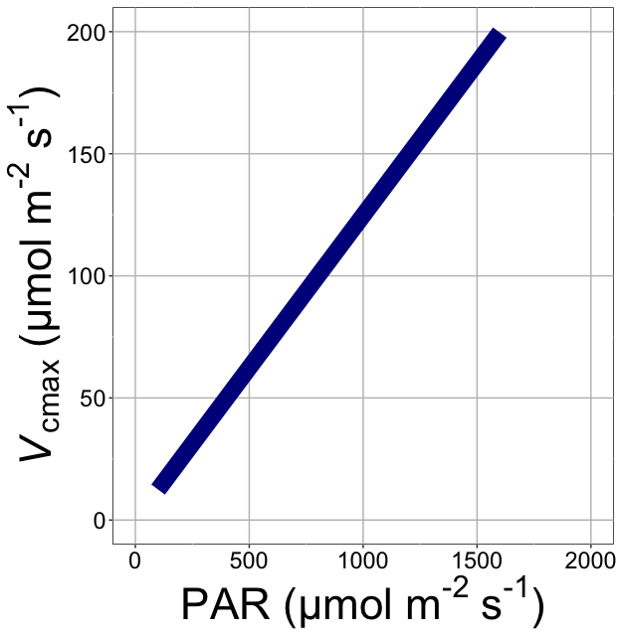
nick.smith@ttu.edu; @nick_greg_smith
V_{cmax} increases with light because of greater electron transport
Smith et al. (2019)

Slide 19
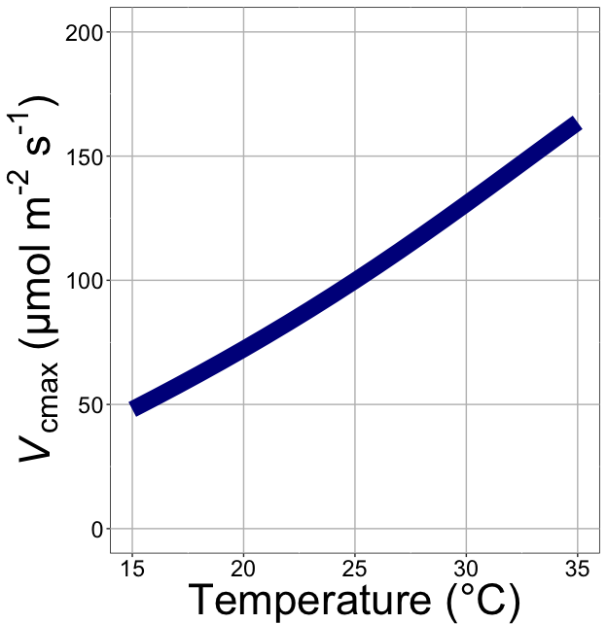
nick.smith@ttu.edu; @nick_greg_smith
V_{cmax} increases with temperature because of greater electron transport and photorespiration
Smith et al. (2019)

Slide 20
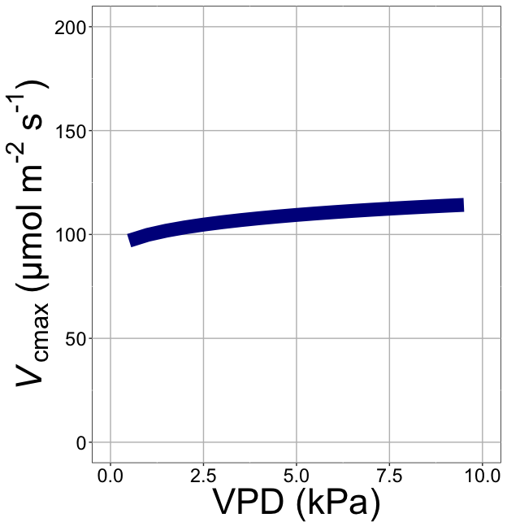
nick.smith@ttu.edu; @nick_greg_smith
V_{cmax} increases with VPD because of lower stomatal conductance
Smith et al. (2019)

Slide 21
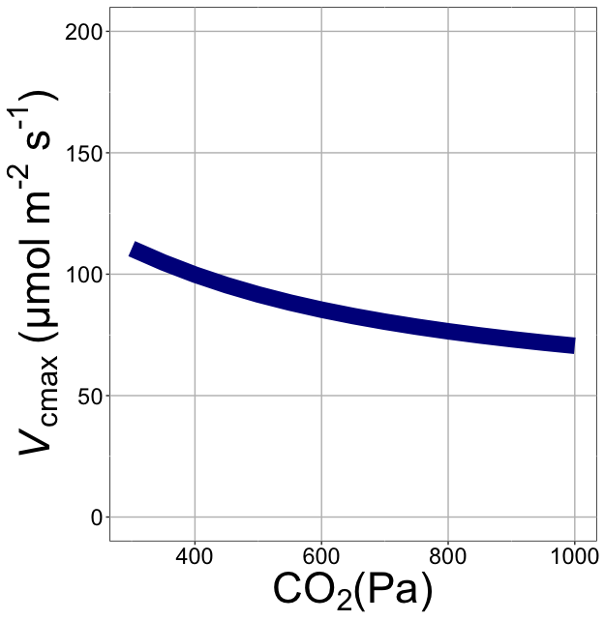
nick.smith@ttu.edu; @nick_greg_smith
V_{cmax} decreases with CO₂ because of greater CO₂ in the leaf
(ppm)
Smith et al. (2019)

Slide 22
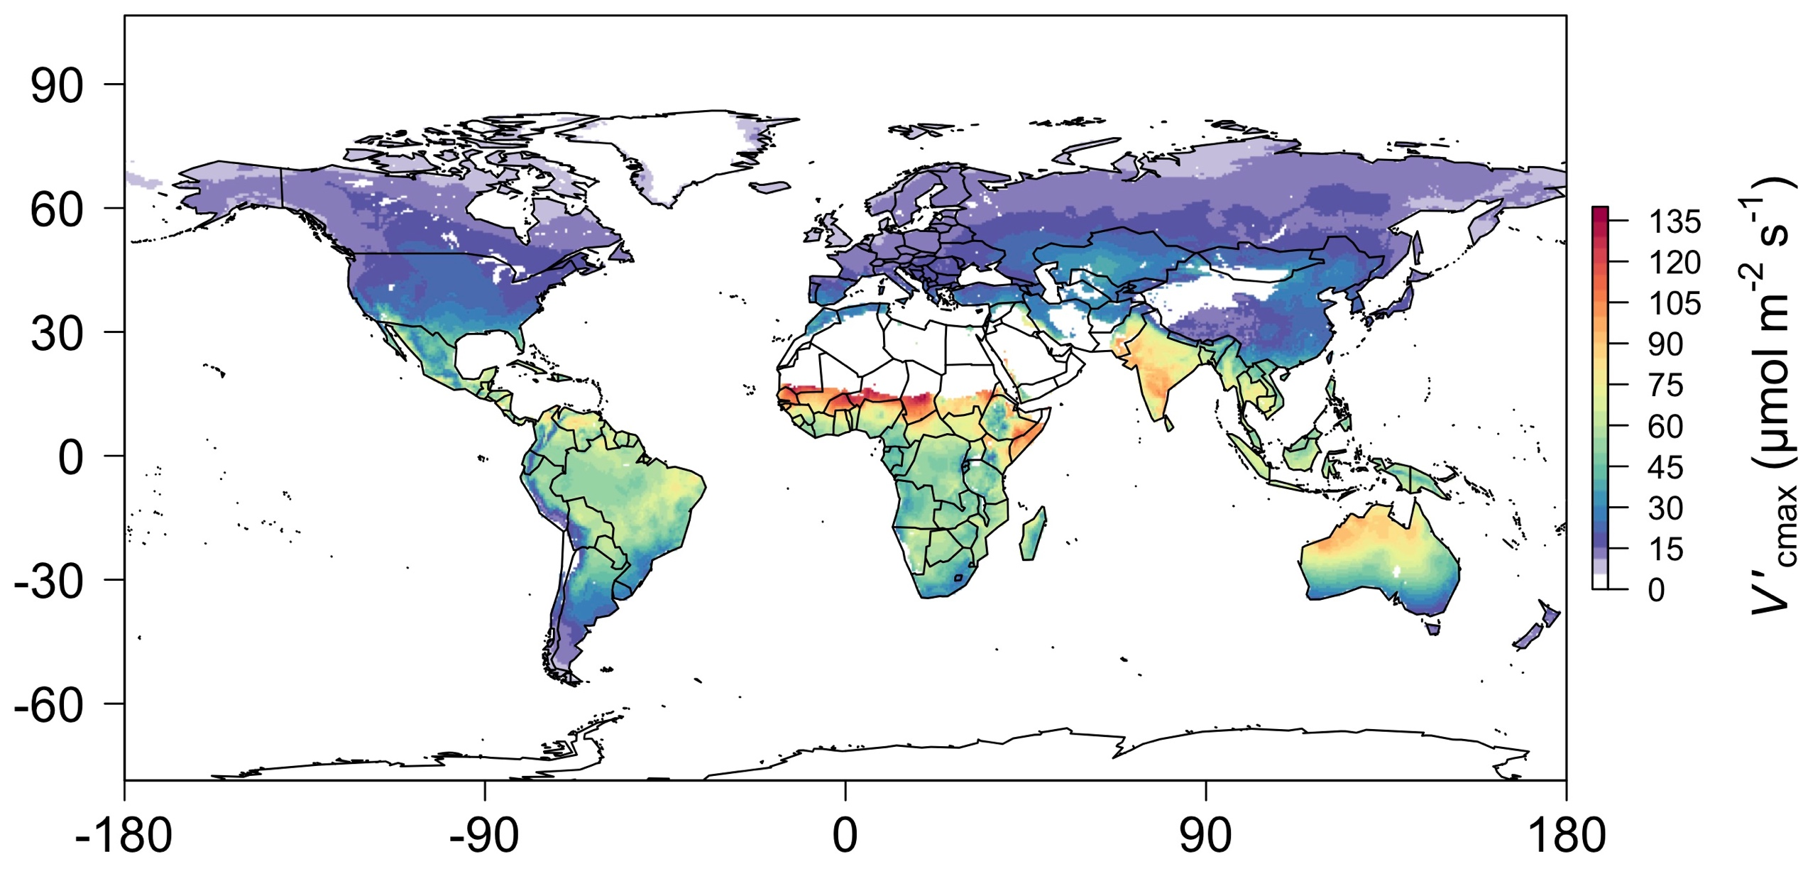
nick.smith@ttu.edu; @nick_greg_smith
Global, optimally acclimated traits!
Smith et al. (2019)

Slide 23
Important note: optimality model adds no free parameters to Farquhar model
nick.smith@ttu.edu; @nick_greg_smith

Slide 24
Land surface models
nick.smith@ttu.edu; @nick_greg_smith

Slide 25
A typical LSM photosynthesis scheme
nick.smith@ttu.edu; @nick_greg_smith
Climate
Soil N
Leaf N
Photosynthesis

Slide 26
Least cost optimality model
nick.smith@ttu.edu; @nick_greg_smith
Climate
Photosynthesis

Slide 27
Let’s check this assumption
nick.smith@ttu.edu; @nick_greg_smith
Climate
Soil N
Leaf N
Photosynthesis

Slide 28
Does leaf N respond to soil N?
nick.smith@ttu.edu; @nick_greg_smith
Each box is proportional to the variance in leaf N explained by each variable
Smith et al. (in prep)

Slide 29
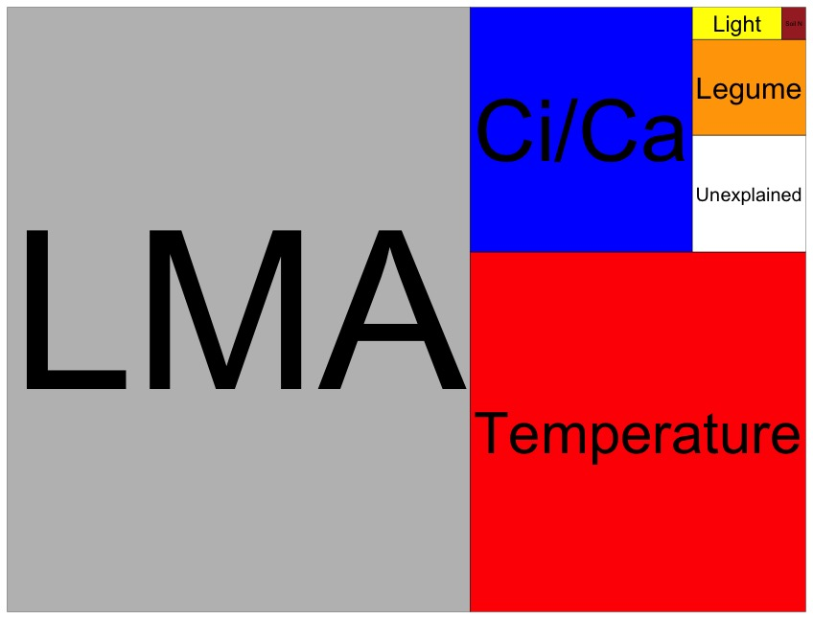
Globally, N addition little impact on leaf N
nick.smith@ttu.edu; @nick_greg_smith
Each box is proportional to the variance in leaf N explained by each variable
Smith et al. (in prep)

Slide 30
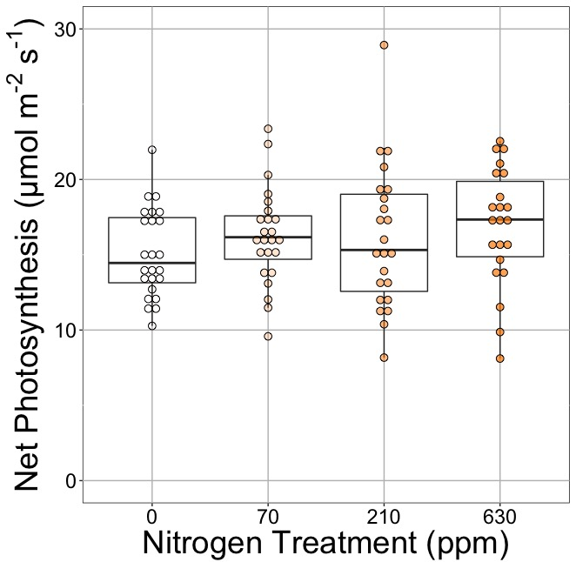
Does photosynthesis respond to soil N?
nick.smith@ttu.edu; @nick_greg_smith
Waring and Smith (in prep)

Slide 31
Photosynthesis does not change with soil N
nick.smith@ttu.edu; @nick_greg_smith
No change (P = 0.42)
Waring and Smith (in prep)

Slide 32
How does the optimality model do?
nick.smith@ttu.edu; @nick_greg_smith
Climate
Photosynthesis

Slide 33

nick.smith@ttu.edu; @nick_greg_smith
Optimal V_{cmax} is similar to observed values
Smith et al. (2019)

Slide 34
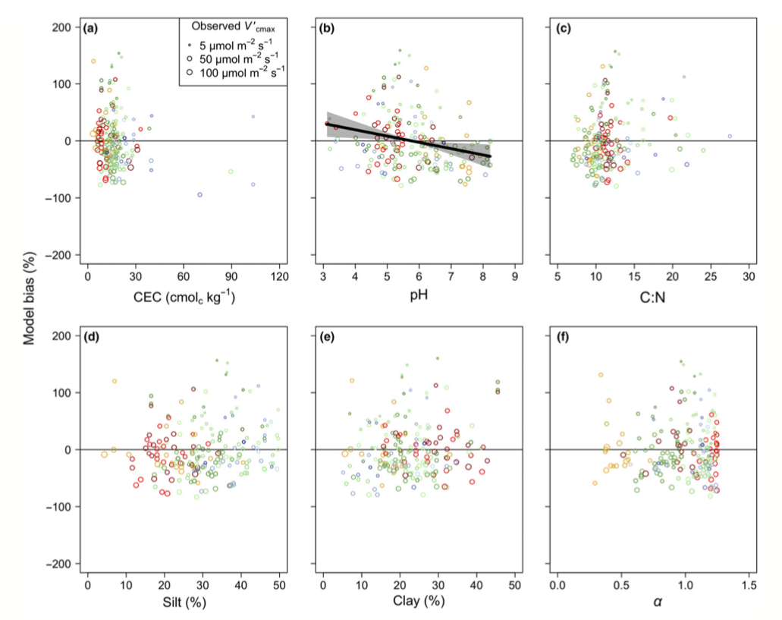
There is little effect of soils on V_{cmax}
nick.smith@ttu.edu; @nick_greg_smith
Soil increased explained variation from 64% to 68% compared to optimal response alone
Smith et al. (2019)

Slide 35
Does it work under future conditions?

Slide 36
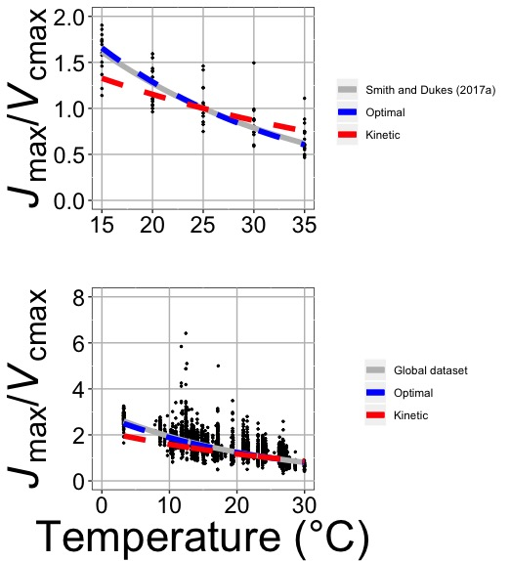
Photosynthetic traits change with temperature in ways expected from optimization
nick.smith@ttu.edu; @nick_greg_smith
Data = -0.051 °C⁻¹
Predicted = -0.048 °C⁻¹
Smith and Keenan (in review)

Slide 37
Photosynthetic traits change with future conditions in ways expected from optimization
nick.smith@ttu.edu; @nick_greg_smith
mean: -12%
mean: -15%
(P > 0.05)
Smith and Keenan (in review)

Slide 38
Implications

Slide 39
Implications
Optimal leaf biochemical setup is determined by climate

Slide 40
Implications
Optimal leaf biochemical setup is determined by climate
Plants mine for N to get the most leaves at the optimal setup

Slide 41
Implications
Optimal leaf biochemical setup is determined by climate
Plants mine for N to get the most leaves at the optimal setup
Photosynthetic demand determines leaf N, not the other way around

Slide 42
Axes need flipped
Kattge et al. (2009)

Slide 43
Implications
Optimal leaf biochemical setup is determined by climate
Plants mine for N to get the most leaves at the optimal setup
Photosynthetic demand determines leaf N, not the other way around
Soil N determines # of leaves (before canopy closure)

Slide 44

Let’s run a model out into the future!
nick.smith@ttu.edu; @nick_greg_smith

Slide 45
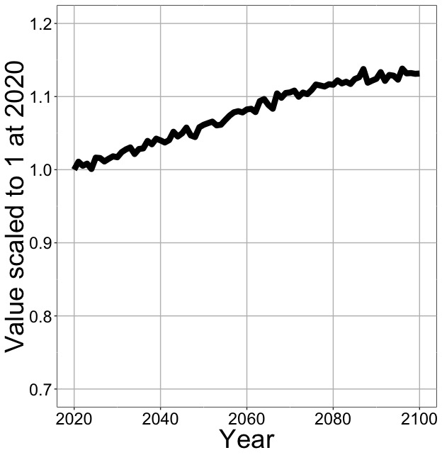
Photosynthesis increases in future
nick.smith@ttu.edu; @nick_greg_smith
Net Photosynthesis
Smith et al. (in prep)

Slide 46
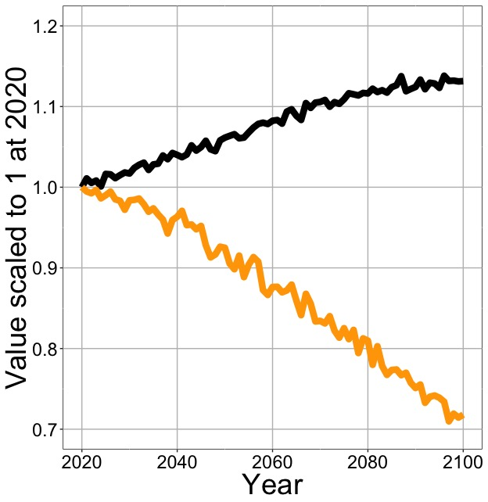
Photosynthesis increases in future (at lower nutrient use)
nick.smith@ttu.edu; @nick_greg_smith
Net Photosynthesis
Leaf Nitrogen
Smith et al. (in prep)

Slide 47
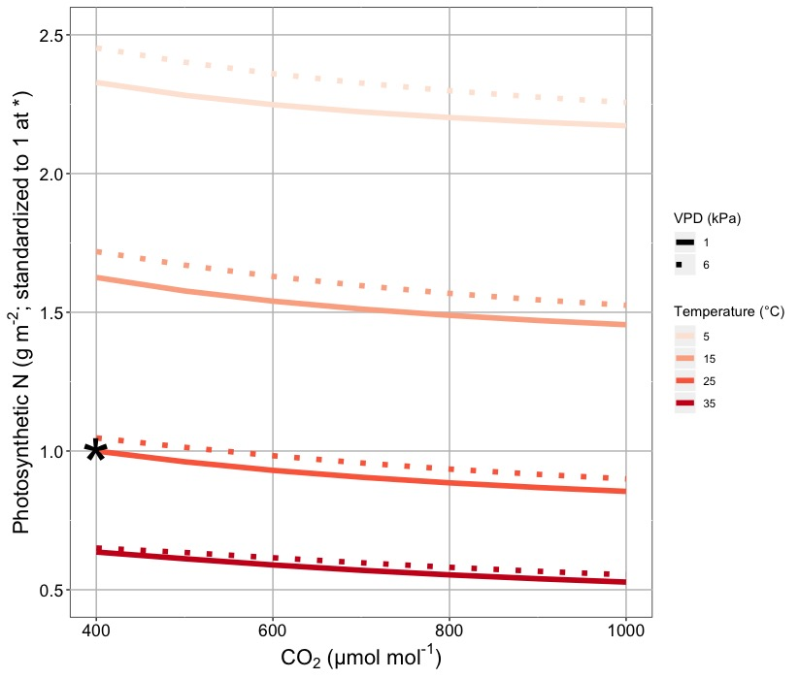
Smith & Keenan (in review)

Slide 48
Next steps: How might this effect simulated nutrient limitation?
nick.smith@ttu.edu; @nick_greg_smith
“No limitation” simulation
“Nutrient limitation” simulations
Weider et al. (2015)

Slide 49
What’s going on?
Optimal leaf biochemical setup is determined by climate
Plants mine for N to get the most leaves at the optimal setup
Photosynthetic demand determines leaf N, not the other way around
Soil N determines # of leaves (before canopy closure)

Slide 50
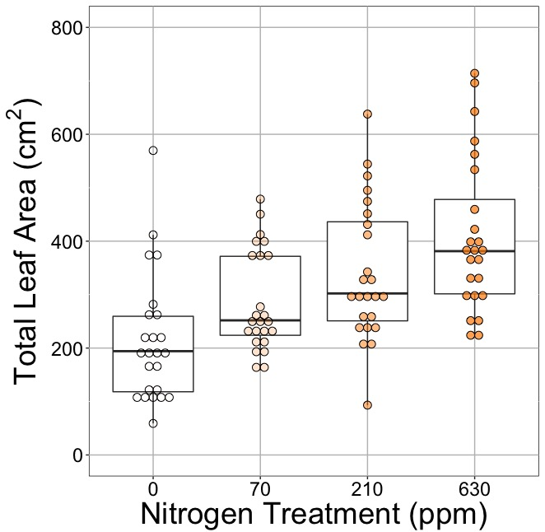
Soil N determines # of leaves?
nick.smith@ttu.edu; @nick_greg_smith
No change (P = 0.42)
91% increase (P < 0.05)
Waring and Smith (in prep)

Slide 51
Conclusions
nick.smith@ttu.edu; @nick_greg_smith
Plants aren’t dumb!
Need to make sure our models reliably simulate acclimation responses
Dumb plants

Slide 52
Conclusions
nick.smith@ttu.edu; @nick_greg_smith
Photosynthetic acclimation is likely to impact ecosystem-scale processes
Allocation
N cycling
Microbial processes (e.g., symbioses)

Slide 53
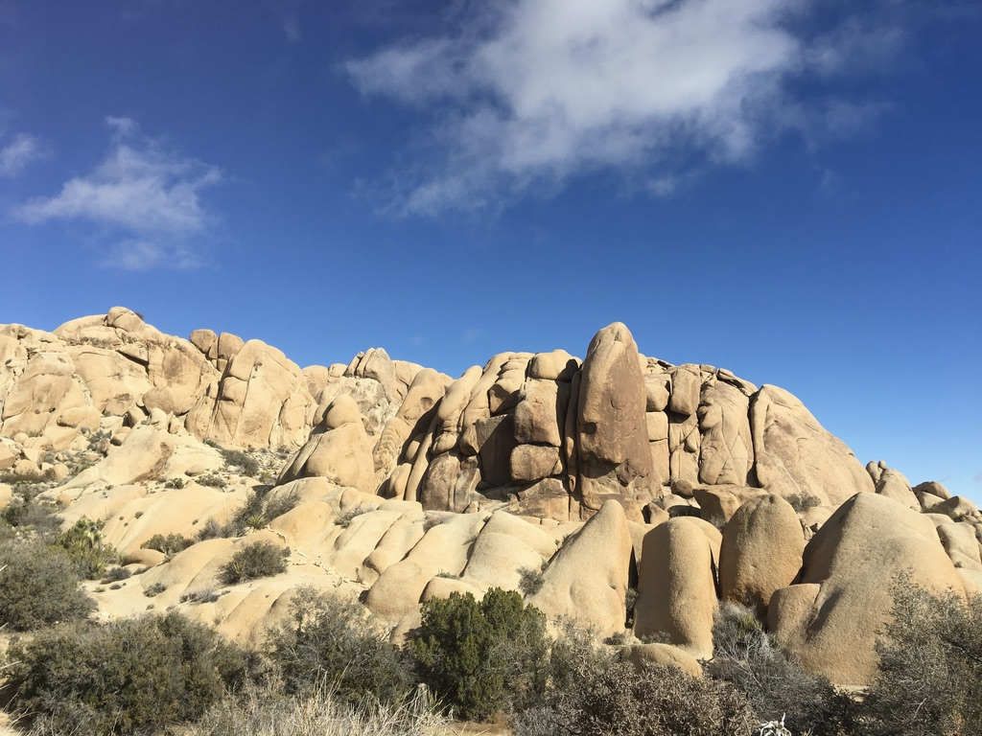
nick.smith@ttu.edu; @nick_greg_smith
Presentation available at:
www.github.com/SmithEcophysLab/seminar/lmwg_2020
Thanks!

Slide 54
Extra slides

Slide 55
Leaf area, but not photosynthesis increases with N addition
nick.smith@ttu.edu; @nick_greg_smith
No change (P = 0.42)
91% increase (P < 0.05)
Waring and Smith (in prep)

Slide 56
nick.smith@ttu.edu; @nick_greg_smith
Open stomata:
Benefits
High CO₂ influx
Costs
High water outflux
Closed stomata:
Benefits
Low water outflux
Costs
Low CO₂ influx

Slide 57
nick.smith@ttu.edu; @nick_greg_smith
Open stomata:
Benefits
High CO₂ influx
Costs
High water outflux
Closed stomata:
Benefits
Low water outflux
Costs
Low CO₂ influx
Must maintain high amount of Rubisco to do photosynthesis

Slide 58
Optimal stomatal conductance
nick.smith@ttu.edu; @nick_greg_smith
Optimal conductance maximizes photosynthesis at least water loss and nutrient use
Water loss is from transpiration
Nutrient use is nutrients used to maintain Rubisco
Rubisco proxy is V_{cmax}

Slide 59
Stomatal conductance trait The ratio of CO₂ in the leaf to CO₂ outside of the leaf (C_{i}/C_{a})
nick.smith@ttu.edu; @nick_greg_smith

Slide 60
nick.smith@ttu.edu; @nick_greg_smith
C_{i}/C_{a} = f{temperature,
CO₂,
vapor pressure deficit}
Prentice et al. (2014); Wang et al. (2017); Smith et al. (2019)

Slide 61
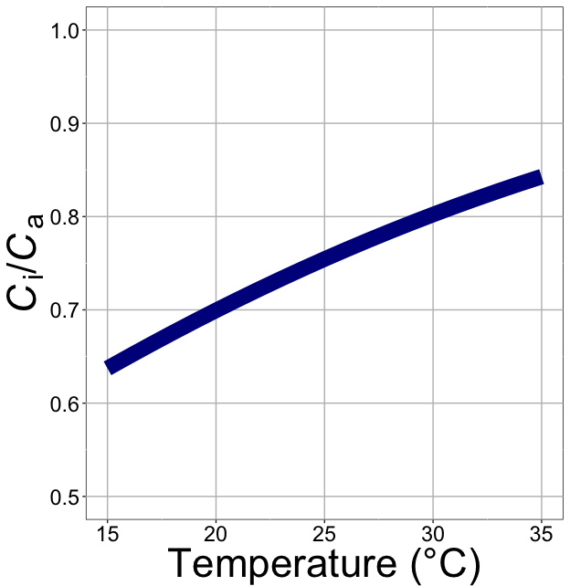
nick.smith@ttu.edu; @nick_greg_smith
C_{i}/C_{a} increases with temperature because of greater photorespiration
Smith et al. (2019)

Slide 62
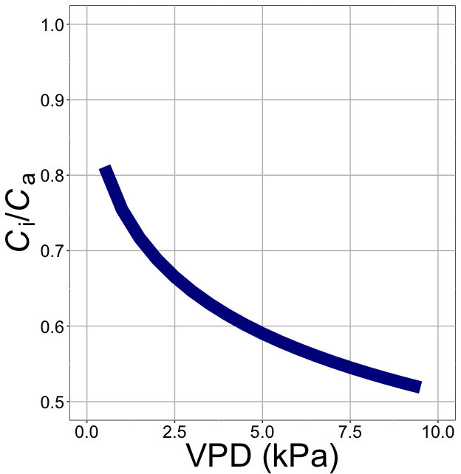
nick.smith@ttu.edu; @nick_greg_smith
C_{i}/C_{a} decreases with VPD because of greater water loss
Smith et al. (2019)

Slide 63
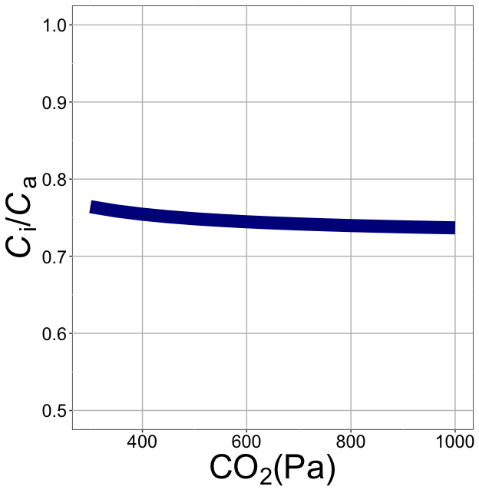
nick.smith@ttu.edu; @nick_greg_smith
C_{i}/C_{a} decreases with CO₂ because of lower openness needed to satisfy Rubisco
Smith et al. (2019)

Slide 64
Photosynthetic acclimation can be seen as the change in the instantaneous responses with longer-term exposure
nick.smith@ttu.edu; @nick_greg_smith
Acclimated to high light

Slide 65
Photosynthetic acclimation can be seen as the change in the instantaneous responses with longer-term exposure
nick.smith@ttu.edu; @nick_greg_smith
Acclimated to high light
Acclimated to low light

